Slide 1
Contents
What is python(main difference between R and python)
Why need to learn python
How to use python
Installation and IDE
Basic syntax
Main library
A whole example
Resources and sharing

Slide 2
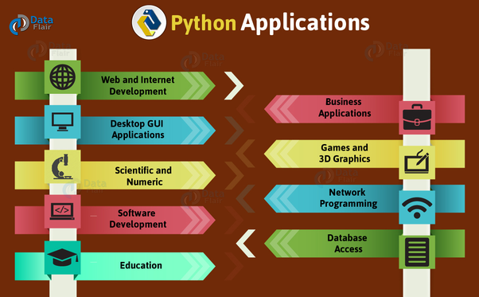
Python
Python is an general purpose programming language. Besides data analysis, it can be able to use in many aspects. That is why it is the most popular programming language recently[IEEE Spectrum].

Slide 3

R vs Python

Slide 4

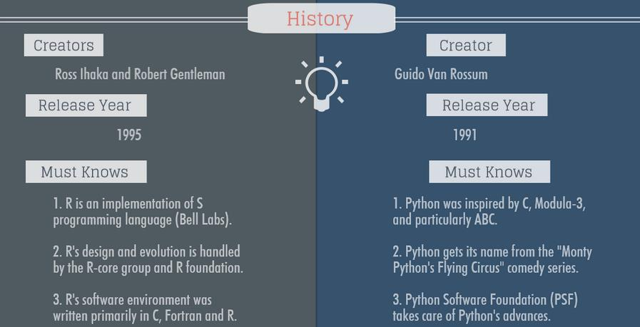
R VS. python
1.R是S程序语言的实现

Slide 5
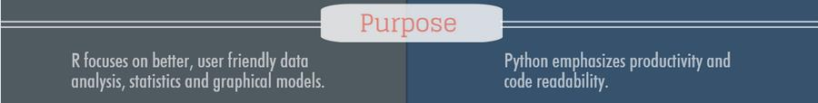
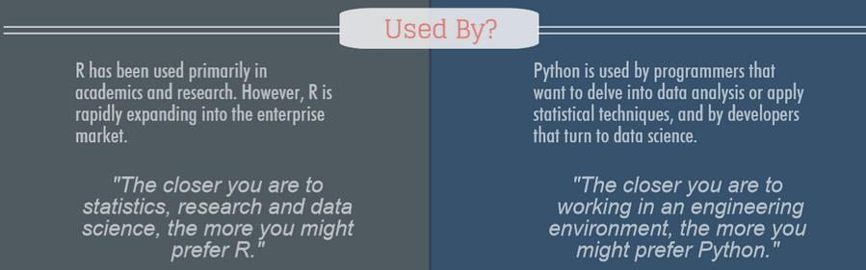
R VS. python

Slide 6
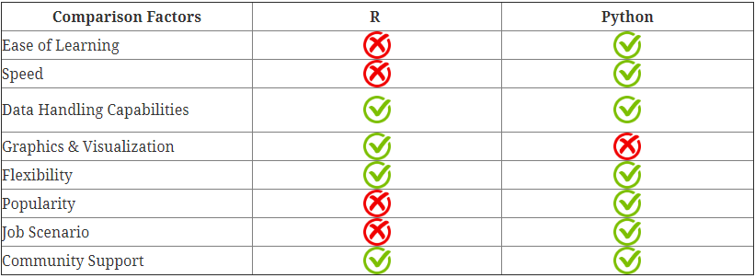
R VS. python

Slide 7
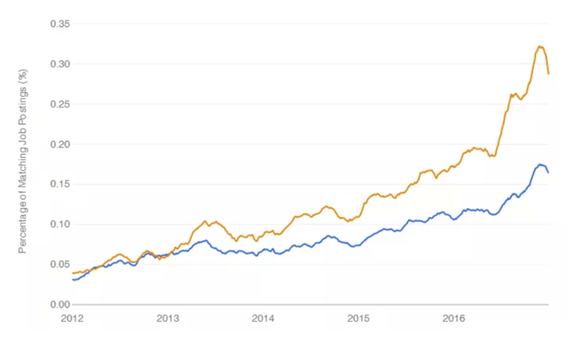
R VS. python
The picture below shows the number of jobs related to data science by programming languages. SQL is far ahead, followed by Python and Java. R ranks 5th. we can see that Python (in yellow) is more often quoted in job description than R(blue) .
R Vs Python: Job Opportunity [Guru99]

Slide 8
Installation and IDE
Installing Python(https://github.com/resbaz/Intro_Python_Nov2017/blob/master/Python_Installation.md)
Anaconda
Pip installer
IDE (Integrated Development Environment)
Spyder = Rstudio
Jupyter notebook = Rmarkdown
Install package
Anaconda has integrated main useful packages, like Numpy, Pandas.
Command line install:https://packaging.python.org/tutorials/installing-packages/
pip install "Some Project"

Slide 9
Main Python library
When using module in python, like “library()”in R, we need to import module in python.
import numpy as np
From math import pi # just import pi as its object

Slide 10
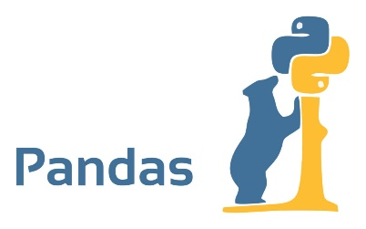
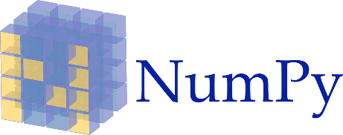



Main Python library
Python -> R
Scikit-learn -> glm, knn, randomForest, e1071
Pandas -> reshape2, dplyr, data.table, lubridate, jsonlite
Matplotlib -> ggplot2

Slide 11
Basic python syntax
Data types: int, float, string, list, tuple, dictionaries
List operation
Setting working dic

Slide 12
Example:

Slide 13
参考资料
[1]Stephen Cass, IEEE Spectrum, The 2018 Top Programming Languages(https://spectrum.ieee.org/at-work/innovation/the-2018-top-programming-languages)
Igor Bobriakov，Comparison of top data science libraries for Python, R and Scala （https://medium.com/activewizards-machine-learning-company/comparison-of-top-data-science-libraries-for-python-r-and-scala-infographic-574069949267）
R vs Python | Best Programming Language for Data Science and Analysis（https://www.codementor.io/sayantinideb/r-vs-python-best-programming-language-for-data-science-and-analysis-te05xgx98）

